Slide 1
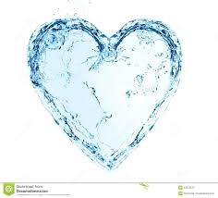
A Collection
of
Poems About Water
By: Miss Gleason’s First Grade Class
Goshen Center School
2015-16

Slide 2
We dedicate this collection of water poems to all the children around the world who don’t have access to water.

Slide 3
Celebration of Learning!
Earlier this year, my first grade students began to explore concepts about water, water scarcity, and the water cycle. Within our reading, writing, and science units of study they researched and read many books, articles, as well as conducting some of their own research and questions they had on the topic. Collaborating writing, art, as well as music the first graders wanted to take their learning to the next level after their experiences with local author Christine Ieronimo. They began to explore the components of poetry. They listened to an array of different water sounds and described what they heard, by making connections using their senses. Each student wrote their pieces about what water means to them.

Slide 4
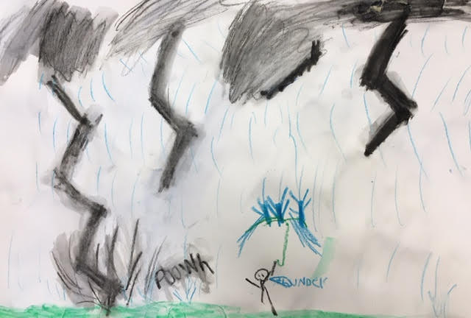
Jameson McTamney
Age: 7
Water is Great!
Water, Water.
It is great.
It goes down a stream.
Rushing water. It goes.
Water.
Drippy water.
Without water you can pass,
Away.
That is why you have explored a new world of water.
Especially at water parks.
Water is for you, it is in you!
Forever!

Slide 5
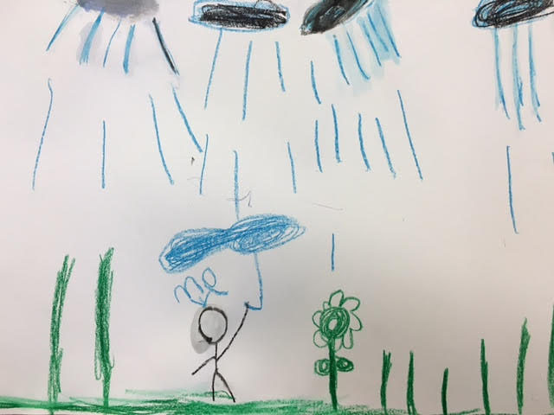
Logan Alford
Age: 7
Water Everywhere!
You can drink water.
You can see water everywhere.
Water is in the sea.
Water is in the ocean.
Water is in the river.
And water is everywhere!

Slide 6
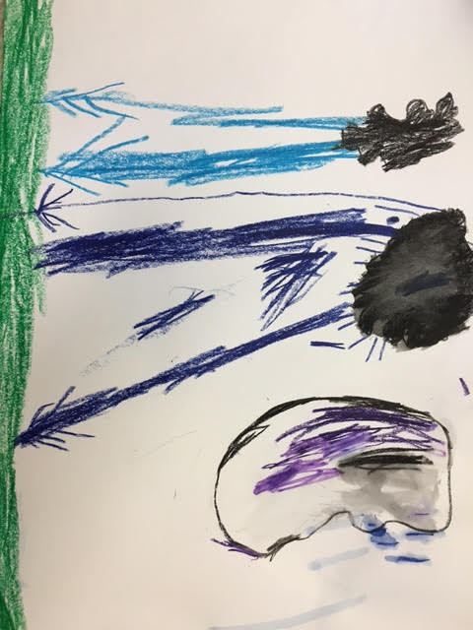
Nathaniel Cowenhoven
Age: 7
Water
Water is everywhere.
You can see water in streams and in rivers.
You can see it in the ocean.
Boats are in the water.
There is water in you.
Rain is water.

Slide 7
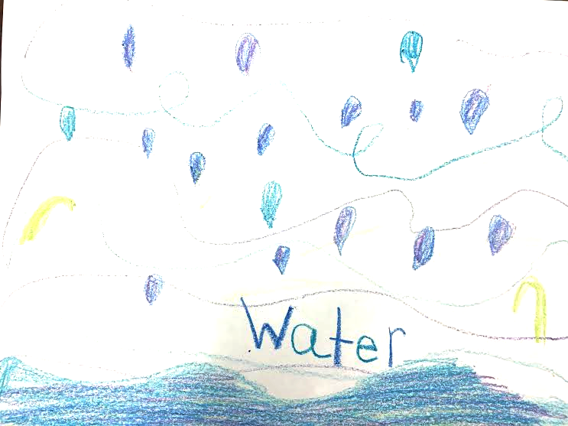
Cali Ciccarelli
Age: 7
Water Is Me!
Water is in your eyes.
Water is in tears.
Water in streams and in oceans,
And in waterfalls.
You can drink water, enjoy!
Water on mountains,
Or just lay there in a puddle.
Water and rain, what fun!
Jumping and playing in water,
More fun!
Water is fun!
There is all different kinds of water: cold, hot, dirty, and clean.
All different sounds: calm, loud, slow or fast.
I love water, how it just sits in your mouth until you swallow.
Water is all around the world.
Water is me!

Slide 8
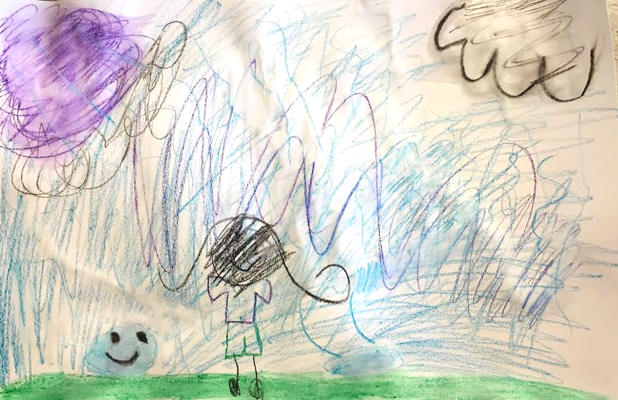
Francesca Vattuone
Age: 6
Water is Special
Water.
You should take care of the water.
It is special for everyone.
It is important for you.
It is you!
I can go to the store and get bottled water,
But many others can not.
They walk and walk for water.
I do not.
I will take care of you.
Water.

Slide 9
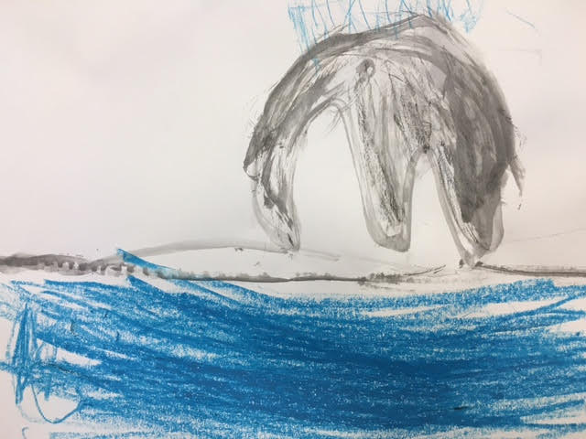
Tyler Fenn
Age: 7
Water Poem!
Water is so much fun!
You can swim and drink water!
Water is important,
Very important.
I love water!!!

Slide 10
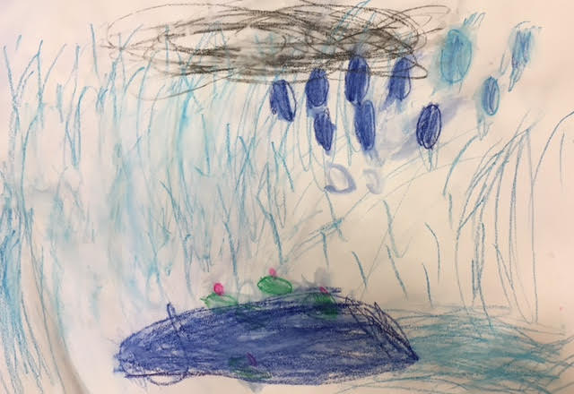
Allison Barber
Age: 7
A Drop of Water
A drop of water.
Water can be hard.
Water can be gentle.
One drop of water can save your life, if in harm.
Water is special to you and me.
A drop of water.

Slide 11
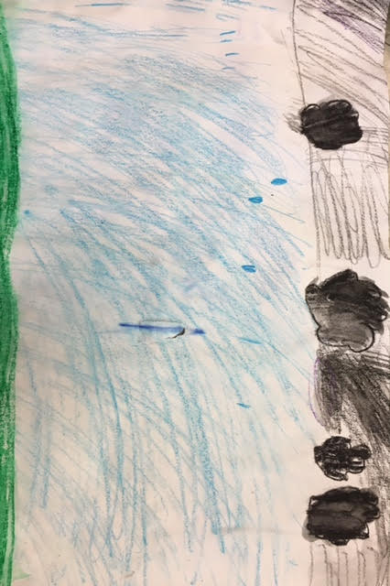
Shyla O’Neill
Age: 7
A Song About Water
Rain drop, rain drop,
Here comes more.
More rain,
And more rain,
And more.
The ocean, the ocean.
It sounds good.
Good out of a seashell,
A seashell.
I like the sound.

Slide 12
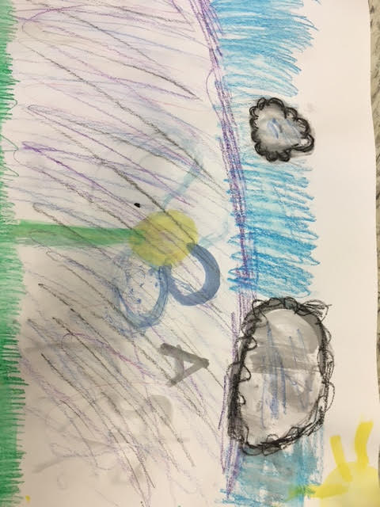
Meghan Carswell
Age: 7
Water is Special
Water is Special,
More special than leprechauns gold.
Water is in places like:
Streams,
Brooks,
Waterfalls,
Or rivers.
Rain is yummy!
Water keeps you hydrated.
Here are books about water:
“A Thirst for Home”,
“I am rain”,
“I love rain”.
I love all different kinds of water!

Slide 13
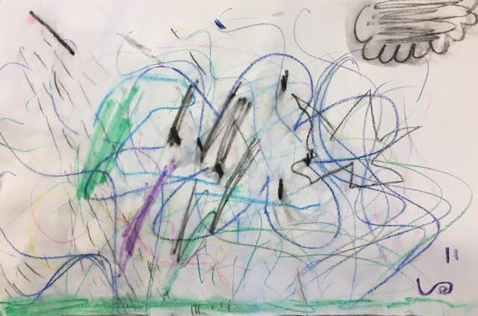
Abigail White
Age: 7
A Drop of Water
Water falls from the sky.
It spreads over mountains and forests.
Over the sky.
You can drink water.
Water comes and goes.
Drips and drops.
It comes from the air,
Onto the ground.
Over the rivers,
To the grass,
Over the pools.
All from a drop of water.

Slide 14
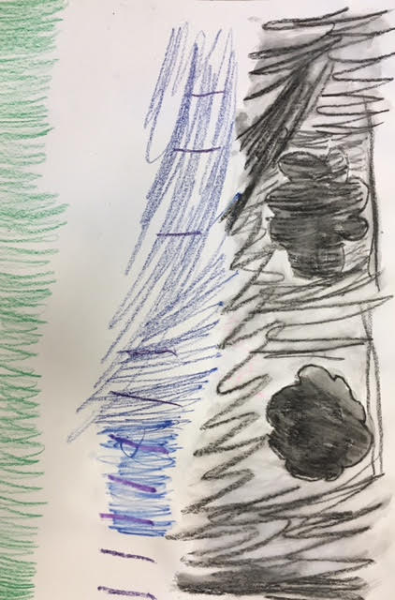
Lollia D’Urso
Age: 7
Water Is Life
Water is life.
Water is important,
For every girl and boy.
Water is everywhere.
You can find it from your faucet.
But some people do not have any water.
They have to travel a long way to get it.
You can not stand a day without a drink of water.
Water is good for you and me.
We need to conserve water because…
Water is good.
Water is life.

Slide 15
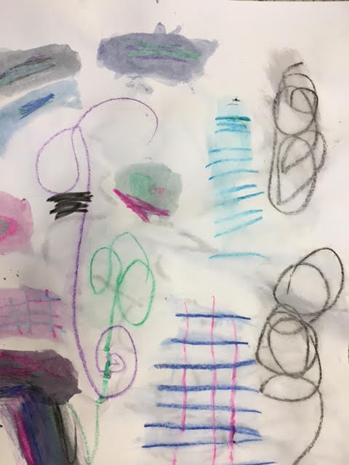
Reagan Masi
Age: 7
Water Is
The water comes from the faucet and a hose.
Like a waterfall.
Fast and powerful.
It can also fill up a bathtub.
You can get a drink of water from the fridge.
It is cold and it tastes wonderful.
Water is all over the world.
You can see water everywhere.

Slide 16
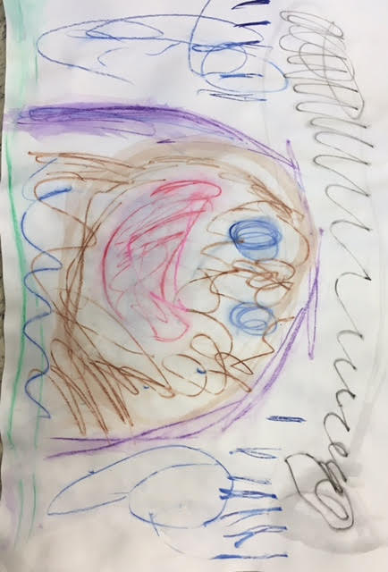
Fern Begley
Age: 6
Droplet of Water
Water is good for everyone.
It is good for girls and boys.
It is good for you and me.
Water can float anywhere,
And any day.
It can go down a waterfall.
It can fall from a cloud in the sky.
All animals need water.
To drink.
And to stay alive.
Plants need it to grow.

Slide 17
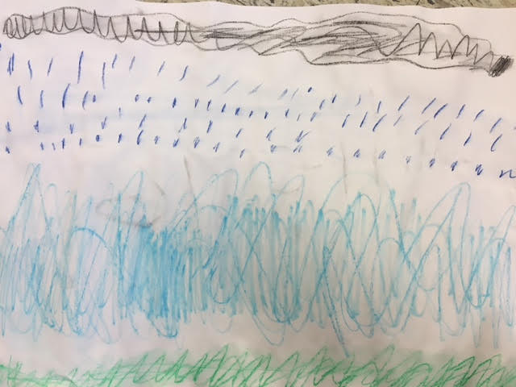
Emilie Vaill
Age: 6
We Must Take Care of Water
Water is special.
I can drink it
And so can you.
Water is clear.
I like to listen to it flow
From a waterfall.
I must take care of water
And so can you!

